Slide 1
Chapter 2
Topic 2.3

Slide 2
Conditional statement
Conditional statements can be written in if p, then q form or in if p, q form. For instance, all of the following are conditional statements.
If we order pizza, then we can have it delivered.
If you go to the movie, you will not be able to meet us for dinner.
If n is a prime number greater than 2, then n is an odd number

Slide 3
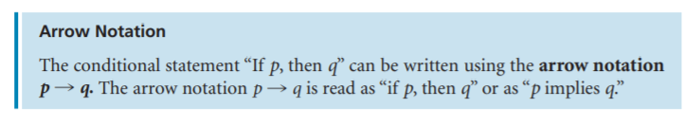
Conditional statement
In any conditional statement represented by “If p, then q” or by “If p, q”, the p statement is called the antecedent and the q statement is called the consequent.
For instance, in the conditional statement,
If our school was this nice, I would go there more than once a week, the antecedent is “our school was this nice” and the consequent is “I would go there more than once a week.”

Slide 4
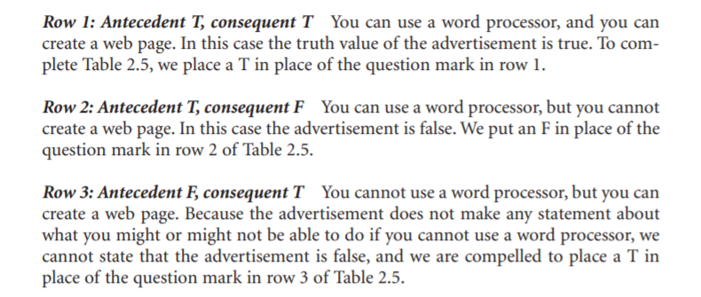
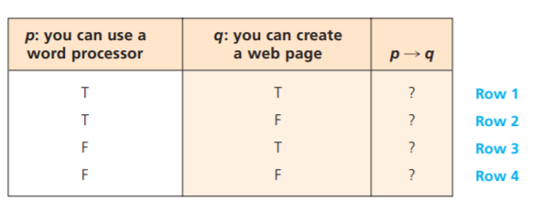
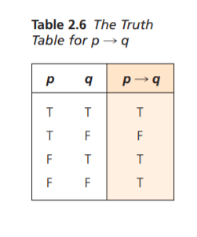
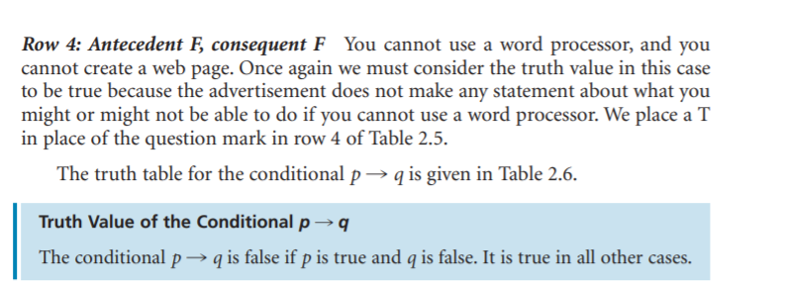
..

Slide 5
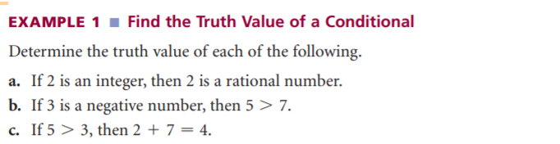

Slide 6
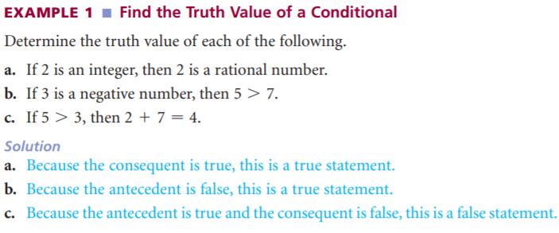

Slide 7
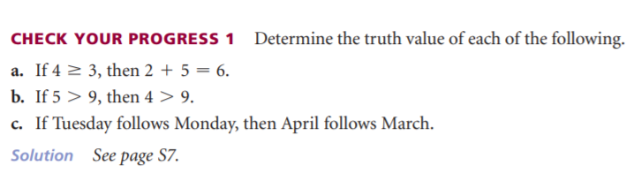

Slide 8
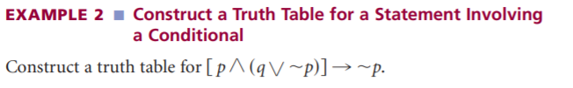

Slide 9
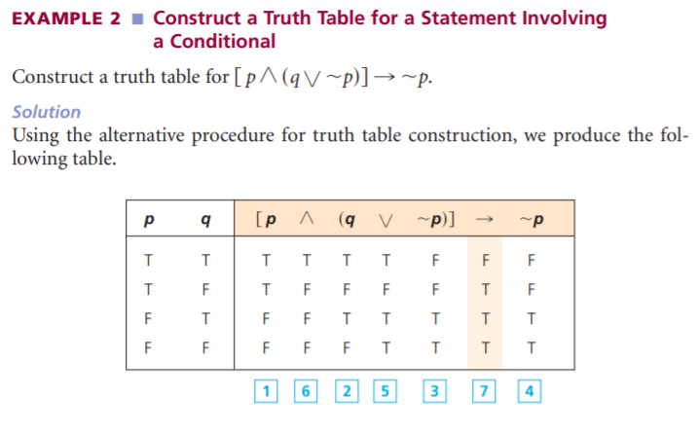


Slide 10
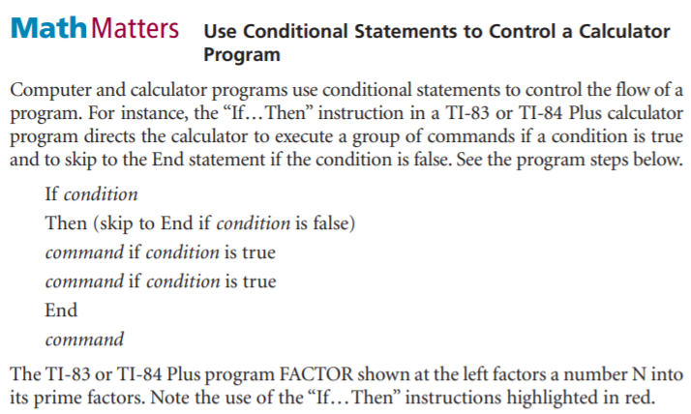

Slide 11
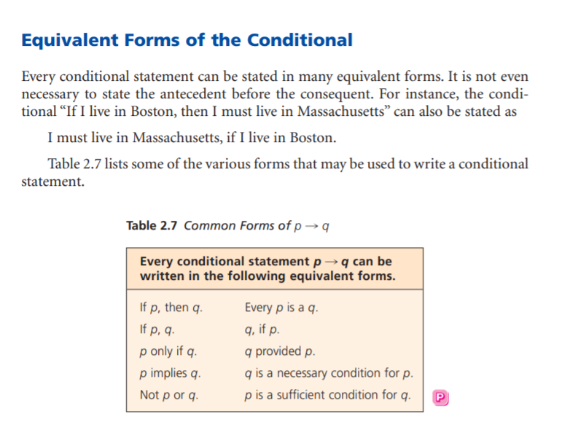

Slide 12
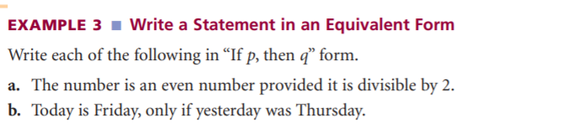

Slide 13
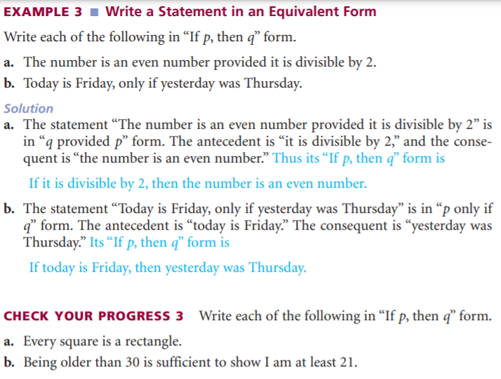

Slide 14
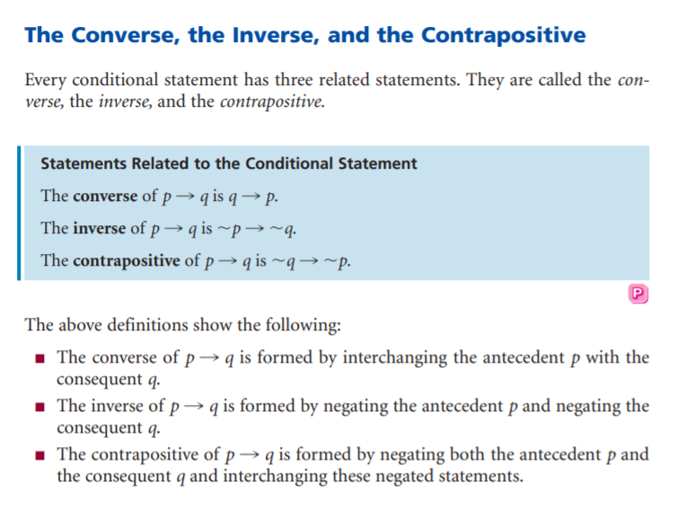

Slide 15
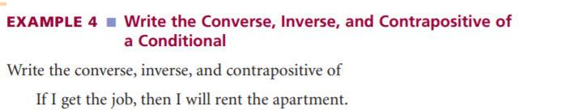

Slide 16
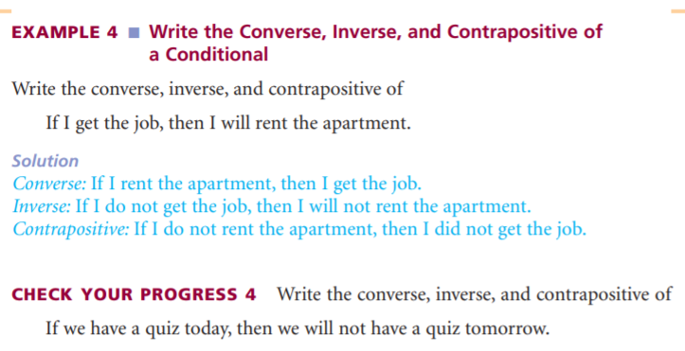

Slide 17

Make truth table of the following
P | q | Conditional

Slide 18
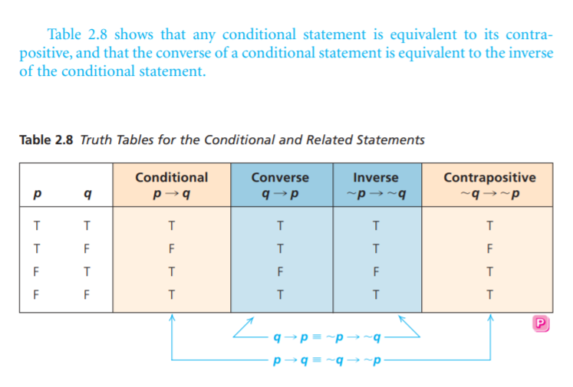

Slide 19
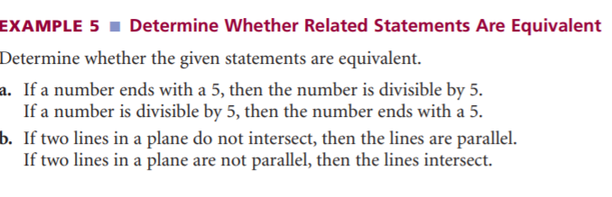

Slide 20
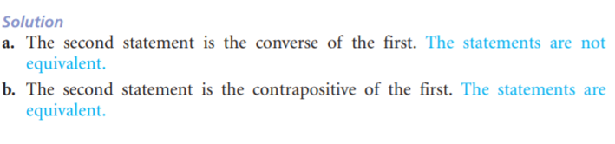

Slide 21
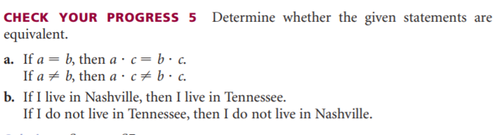

Slide 22
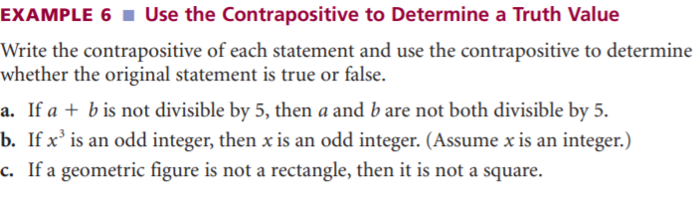

Slide 23
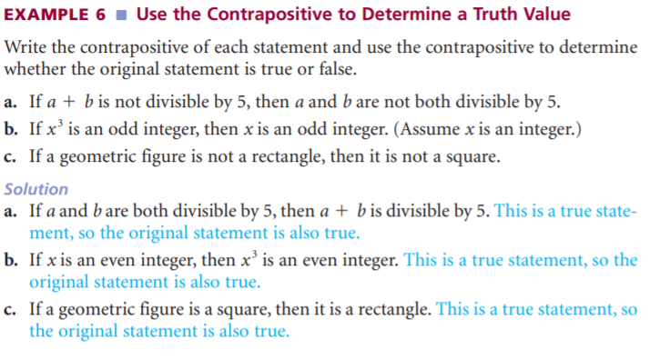

Slide 24
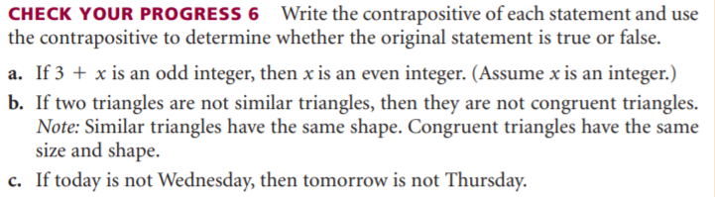

Slide 25
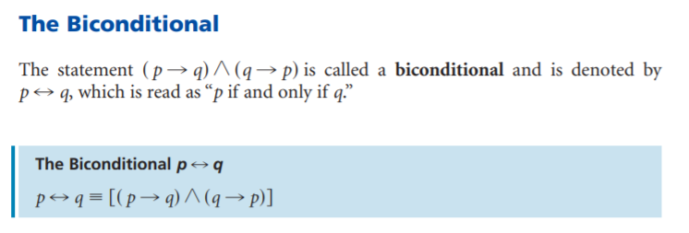
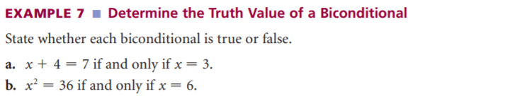
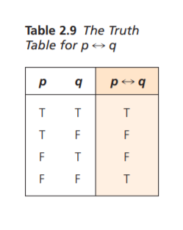

Slide 26
